Slide 1
Good local investigations
Getting it right first time

Slide 2

The local investigation:
Getting it right first time
Has the complaint been handled in line with:
NHS Complaints Regulations
Ombudsman’s Principles of Good Complaint Handling
Ombudsman’s Principles for Remedy
Local policy and procedures

Slide 3
The local investigation:
Getting it right first time
What do you want when you complain?

Slide 4

The local investigation:
Getting it right the first time
What people want in decision making
Where possible, a swift outcome.
A real opportunity to be heard and to input into the process before decisions are made.
To see how decisions are made via clear, understandable and transparent rules.
For complaints handlers to show they’re acting sensitively and impartially – by basing decisions on objective information and appropriate criteria.

Slide 5
Initial contact
A real opportunity to be heard and to input into the process before decisions are made.
  Listen carefully – confirm concerns/matters to be investigated
  Ask what they want to achieve (can it be delivered now?)
  If appropriate, manage expectations and explain what is possible
  Explain how long the process is likely to take – be open and realistic
  Agree how to keep them updated/involved and how often
  Explain what will happen

Slide 6
Evidence-based decision making
To see how decisions are made via clear, understandable and transparent rules.
  Explain investigation process at the start
  What evidence will be considered
  Who you will speak to
  Who will give advice/independent opinion
  How you will decide if the care/service was right or not
  Who will be involved in decision making

Slide 7
Your decision
For complaints handlers to show they’re acting sensitively and impartially – by basing decisions on objective information and appropriate criteria
  Remember your audience – appropriate language and empathy
  Be impartial
  Set out all relevant evidence
  Set out your ‘test’ (ideally use the Ombudsman’s)
  Make sure your decision/the outcome is clear
  Explain any action taken

Slide 8
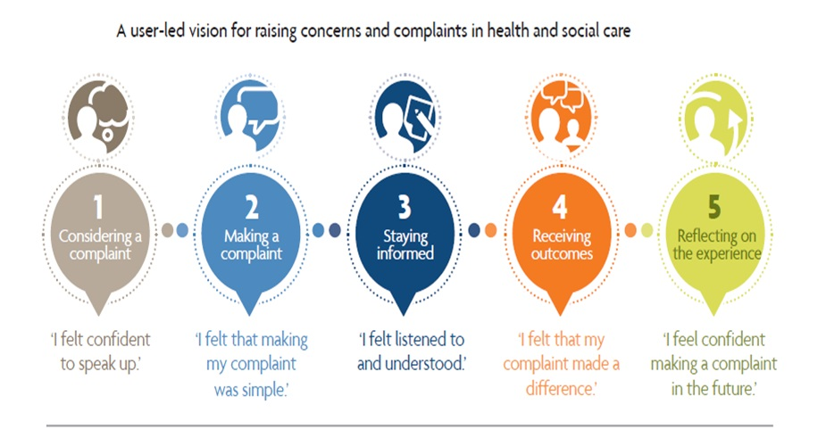
Improving the complaints process
My Expectations

Slide 9


Sharing learning:
Good local response
Response should set out:
The issues raised and what the complainant wants to achieve
How you have investigated and the evidence considered including:
  the complainant’s evidence
  staff/witness statements
  relevant extracts from clinical records
  independent clinical opinion

Slide 10
Sharing learning:
Good local response
Explanation of whether or not something went wrong, by setting out:
  what happened - with reference to the evidence
  what should have happened - quoting relevant regulations, standards, policies, or published guidance, and if they were met
Your view of care/service provided in appropriate, clear, empathetic language
If there is a shortfall (between what happened and what should have happened) an explanation of the shortfall and the impact it has had

Slide 11

Sharing learning:
Good local response
If failings have caused injustice or hardship – suitable apology and redress
If appropriate, explain how it will be put right for other service users
Explain how the complainant will be updated/involved in the changes
Signpost to the Ombudsman service

Slide 12
NHS complaints received
2013/14 – 2017/18

Slide 13
Fully and partly upheld complaints 2016/17 and 2017/18

Slide 14
[INSERT TRUST NAME] data
 | Complaints Received | Accepted for investigation (Investigations concluded) | Upheld | Partly upheld | Not upheld | Discontinued/ Resolved without finding
2015/16
2016/17
2017/18
2018/19*
* 2018/19 data as at [insert report date]

Slide 15
National picture 2017/18
Top substance issues acute trusts
Top complaint handling issues acute trusts
Diagnosis – delay, failure to diagnose, misdiagnosis
Access to services/treatment
Communication and information (including confidentiality) with patients/families
Planning of care, admission, discharge, transfer
Failure to treat
Complaint response is wrong and/or incomplete.
Response to complaint is delayed
Insufficient personal remedy and/or apology
Insufficient actions planned to improve services
Conclusions unsound and/or not evidence based/wrong guidelines used

Slide 16
Feedback and questions
?
Questions?
Any thoughts and experiences of PHSO’s service?
What more could PHSO do to support you?

Slide 17



Thank you
Website
www.ombudsman.org.uk
@PHSOmbudsman
Helpline
0345 015 4033
8.30am - 5.30pm Monday to Friday
Parliamentary and Health Service Ombudsman
Email
liaisonmanagers@ombudsman.org.uk
Radio Ombudsman Podcast

