Slide 1
Good local investigations
Getting it right first time

Slide 2
The local investigation: Getting it right first time
Has the complaint been handled in line with:
Ombudsman’s Principles of Good Administration
Ombudsman’s Principles of Good Complaint Handling
Ombudsman’s Principles for Remedy
Departmental/agency policy and procedures

Slide 3
The local investigation: Getting it right first time
What do you want when you complain?

Slide 4
The local investigation: Getting it right the first time
What people want in decision making
Where possible, a swift outcome.
A real opportunity to be heard and to input into the process before decisions are made.
To see how decisions are made via clear, understandable and transparent rules.
For complaints handlers to show they’re acting sensitively and impartially – by basing decisions on objective information and appropriate criteria.

Slide 5
Initial contact
A real opportunity to be heard and to input into the process before decisions are made.
Listen carefully – confirm concerns/matters to be investigated
Ask what they want to achieve (can it be delivered now?)
If appropriate, manage expectations and explain what is possible
Explain how long the process is likely to take – be open and realistic
Agree how to keep them updated/involved and how often
Explain what will happen

Slide 6
Evidence-based service/decision making was right or not
To see how decisions are made via clear, understandable and transparent rules.
Explain investigation process at the start
What evidence will be considered
Who you will speak to
Who will give advice/independent opinion
How you will decide if the service/decisions making was right or not
Who will be involved in decision making

Slide 7
Your decision
For complaints handlers to show they’re acting sensitively and impartially – by basing decisions on objective information and appropriate criteria
Remember your audience – appropriate language and empathy
Be impartial
Set out all relevant evidence
Set out your ‘test’ (ideally use the Ombudsman’s)
Make sure your decision/the outcome is clear
Explain any action taken

Slide 8
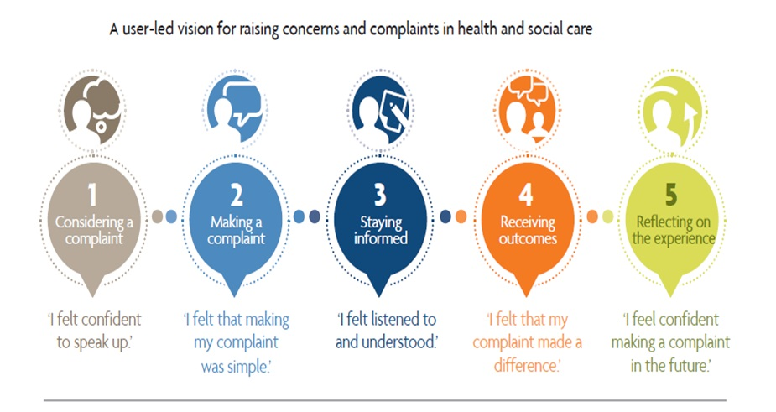
Improving the complaints process My Expectations

Slide 9
Sharing learning: Good local response
Response should set out:
The issues raised and what the complainant wants to achieve
How you have investigated and the evidence considered including:
the complainant’s evidence
staff/witness statements
relevant extracts from departmental records

Slide 10
Sharing learning: Good local response
Explanation of whether or not something went wrong, by setting out:
what happened - with reference to the evidence
what should have happened - quoting relevant regulations, standards, policies, or published guidance, and if they were met
Your view of service provided in appropriate, clear, empathetic language
If there is a shortfall (between what happened and what should have happened) an explanation of the shortfall and the impact it has had

Slide 11
Sharing learning: Good local response
If failings have caused injustice or hardship – suitable apology and redress
If appropriate, explain how it will be put right for other service users
Explain how the complainant will be updated/involved in the changes
Signpost to the next stage/Ombudsman service

Slide 12
Feedback and questions
?
Questions?
Any thoughts and experiences of PHSO’s service?
What more could PHSO do to support you?

Slide 13
Thank you
Website
www.ombudsman.org.uk
@PHSOmbudsman
Helpline
0345 015 4033
8.30am - 5.30pm Monday to Friday
Parliamentary and Health Service Ombudsman
Email
liaisonmanagers@ombudsman.org.uk
Radio Ombudsman Podcast

